Slide 1
Don't Write Secure Code! (Build secure systems instead)
Seth Petry-Johnson @spetryjohnson

Slide 2
I hate writing secure code

Slide 3
I hate writing secure code I hate writing secure features

Slide 4
I hate writing secure code I hate writing secure features I hate implementing cross-cutting security concerns by repeating the same patterns over and over again in my feature-level code

Slide 5
What's on the agenda?
Define "cross cutting" security concerns

Slide 6
What's on the agenda?
Define "cross cutting" security concerns
"Secure by default" examples

Slide 7
What's on the agenda?
Define "cross cutting" security concerns
"Secure by default" examples
Declarative vs Imperative security

Slide 8
What's on the agenda?
Define "cross cutting" security concerns
"Secure by default" examples
Declarative vs Imperative security
Audit / Testing

Slide 9
Application "framework"
Any code that leverages "hooks"
in the underlying system

Slide 10
What framework stuff can I tap into?
MVC ActionFilter attributes (OnActionExecuting)
ORM interceptors (connection opened)
jQuery AJAX events (ajaxStart, ajaxEnd, ajaxPrefilter)
PostSharp (property access, method boundaries)

Slide 11
"Cross cutting" concern
Any security requirement that
spans multiple features

Slide 12

"Cross cutting" concerns
Security Requirements:
User must be logged in
Users with the "Manage Orders" permission see all Orders
Everyone else sees only their own Orders

Slide 13
"Cross cutting" concerns
Security Requirements:
User must be logged in
Users with the "Manage Orders" permission see all Orders
Everyone else sees only their own Orders

Slide 14
"Cross cutting" concerns

Slide 15
"Cross cutting" concerns

Slide 16
"Cross cutting" concerns

Slide 17
"Cross cutting" concerns

Slide 18
"Cross cutting" concerns

Slide 19
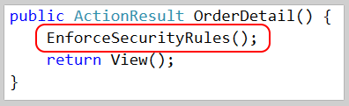
"Cross cutting" concerns

Slide 20
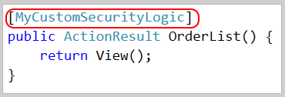
"Cross cutting" concerns

Slide 21

"Cross cutting" concerns

Slide 22
What makes a concern "cross cutting"?
Orthogonal to feature-specific business rules
Applies to multiple features

Slide 23
What belongs in the "framework"?
All "cross-cutting" concerns
Anything that can be made "secure by default"
Anything that needs auditing / global testing

Slide 24
Show me the codez! bit.ly/2i0J91d

Slide 25
SQL Injection Little Bobby Tables, at it again

Slide 26
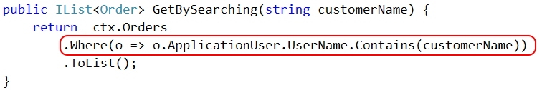

SQL Injection

Slide 27
Cross Site Request Forgery Fun fact*: users never log out. Ever.
* Not actually a fact.

Slide 28
Cross Site Request Forgery (CSRF)

Slide 29
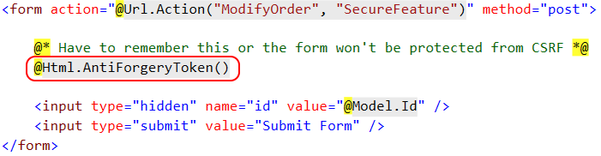
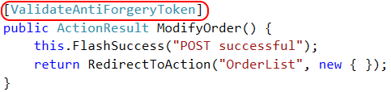
CSRF Defense – feature

Slide 30

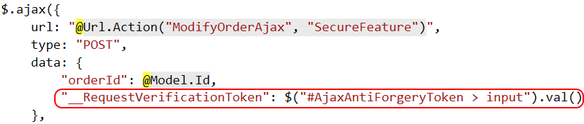
CSRF Defense – feature (ajax)

Slide 31
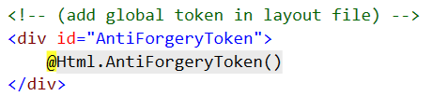
CSRF Defense – cross cutting

Slide 32
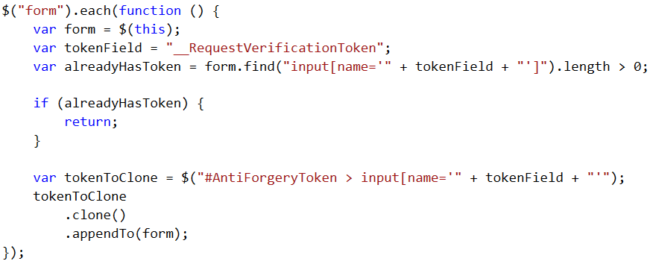
CSRF Defense – cross cutting

Slide 33
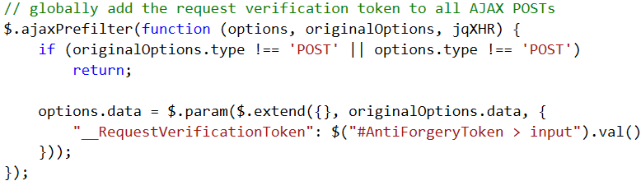
CSRF Defense – cross cutting

Slide 34
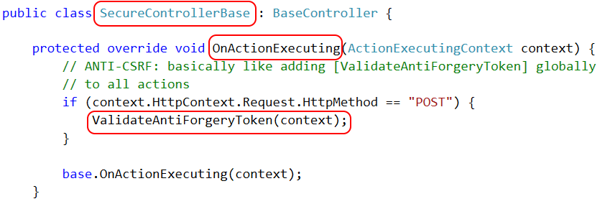
CSRF Defense – cross cutting

Slide 35

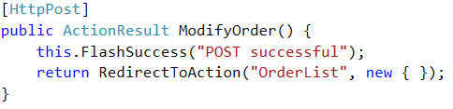
CSRF Defense – cross cutting

Slide 36
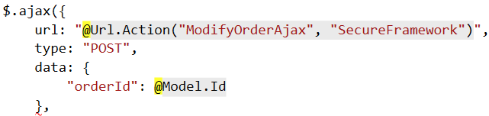
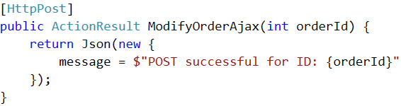
CSRF Defense – cross cutting (ajax)

Slide 37
Authentication Keeping out the unwashed masses

Slide 38
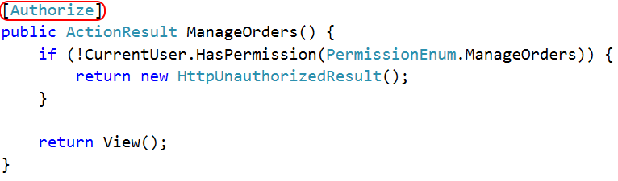
Authentication

Slide 39
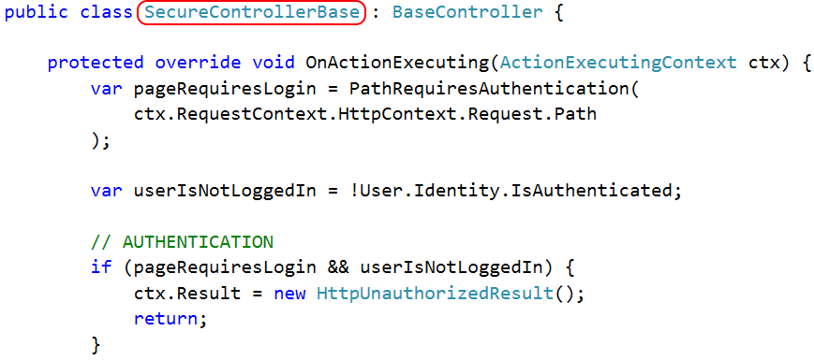
Authentication

Slide 40
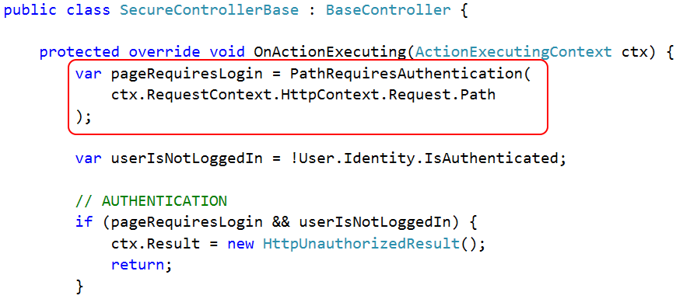
Authentication

Slide 41
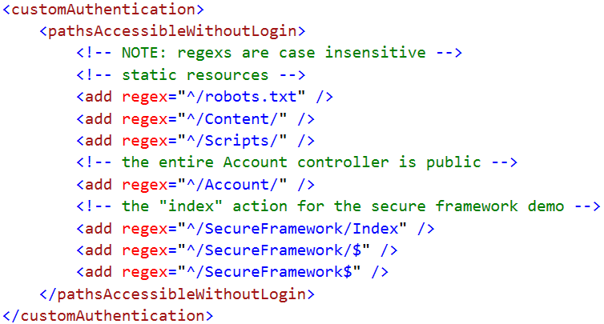
Authentication

Slide 42
Authentication

Slide 43
Access Control Keeping Bob's hands off Alice's data

Slide 44
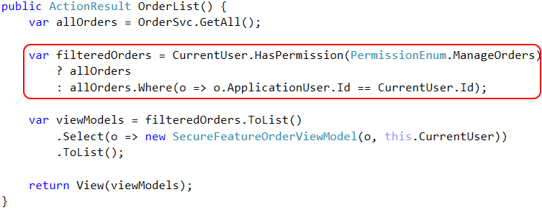
Access Control – feature

Slide 45
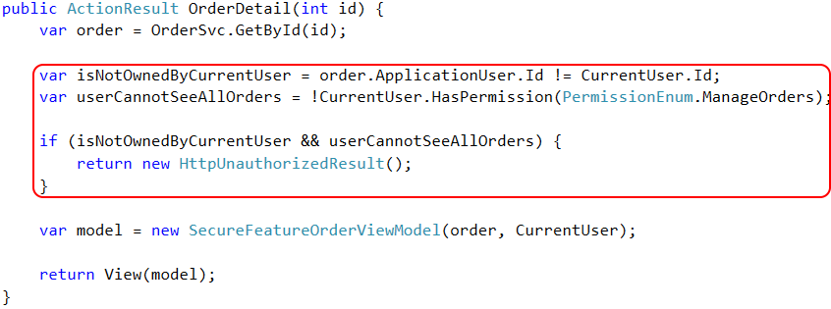
Access Control – feature

Slide 46
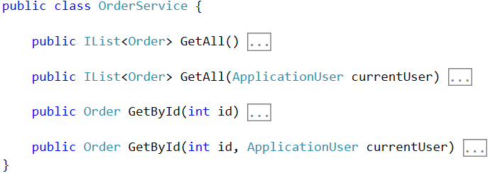
Access Control – framework

Slide 47
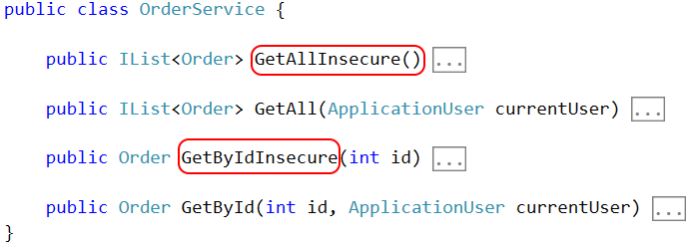
Access Control – framework

Slide 48
Access Control – Row Level Security

Slide 49
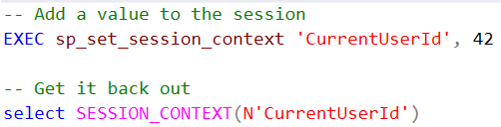

Access Control – Row Level Security

Slide 50
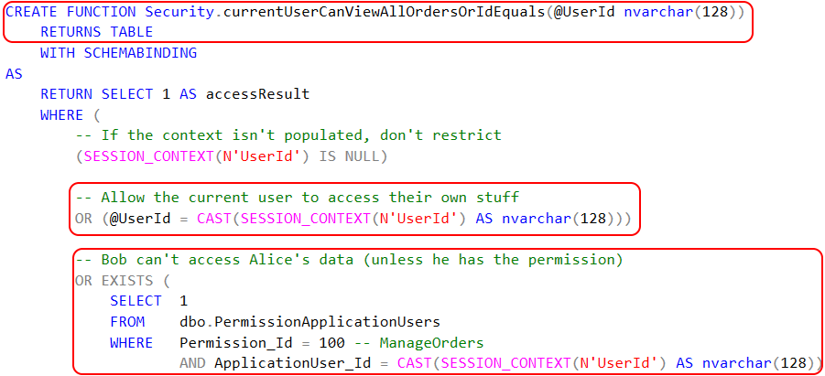
Access Control – Row Level Security

Slide 51

Access Control – Row Level Security

Slide 52
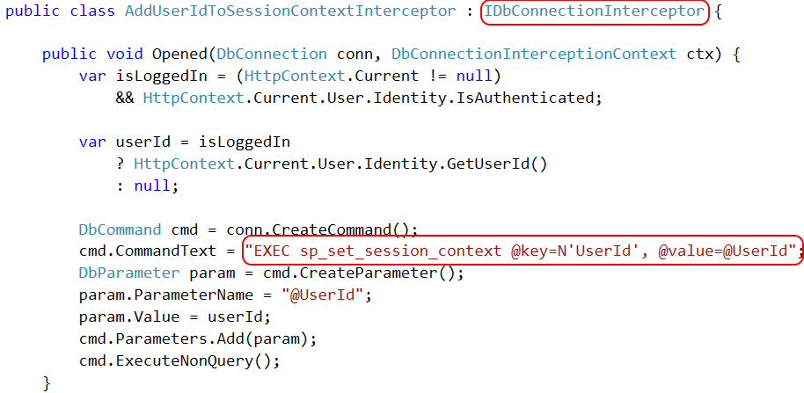
Access Control – Row Level Security

Slide 53
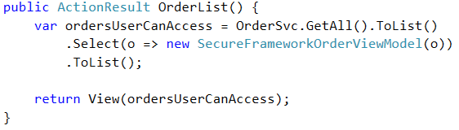
Access Control – framework

Slide 54
Page-level Authorization Keeping Bob in his sandbox

Slide 55
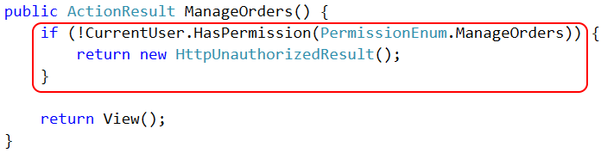
Page Authorization – feature

Slide 56
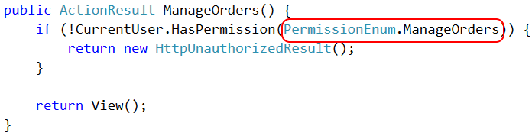
Page Authorization – feature

Slide 57

Page Authorization – cross cutting

Slide 58
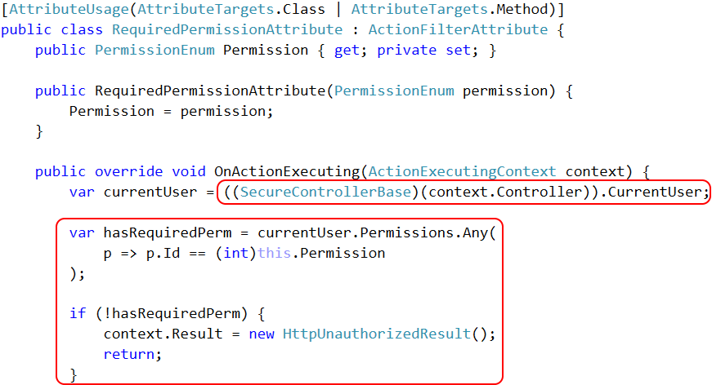

Slide 59
Property-level Authorization Keeping private data private!

Slide 60
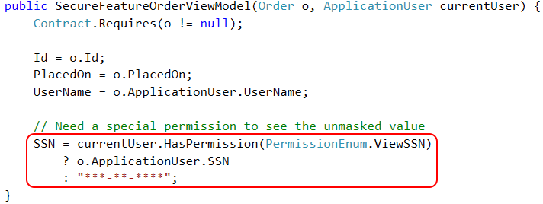
Property Authorization – feature

Slide 61
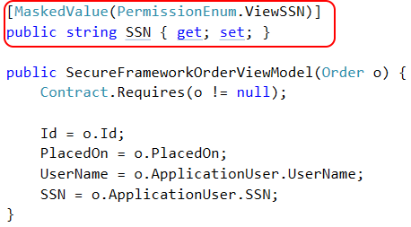
Property Authorization – cross cutting

Slide 62
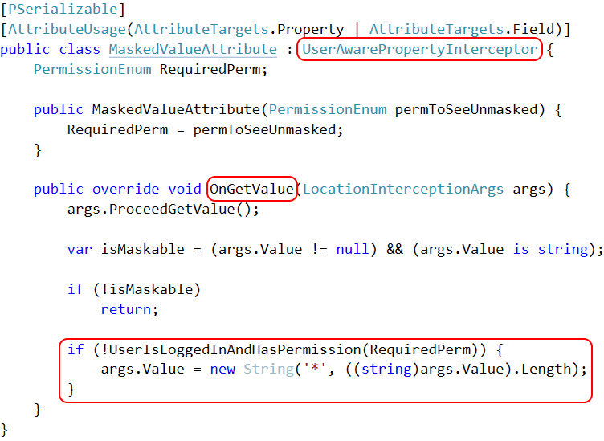

Slide 63
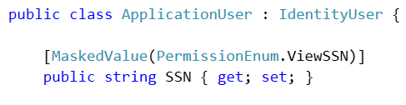
Property Authorization – cross cutting

Slide 64

Property Encryption – cross cutting

Slide 65
Auditing and Testing Try this with your fancy dynamic language!

Slide 66
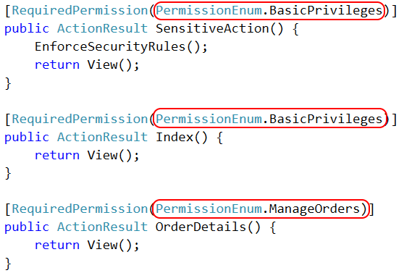
Authorization auditing

Slide 67
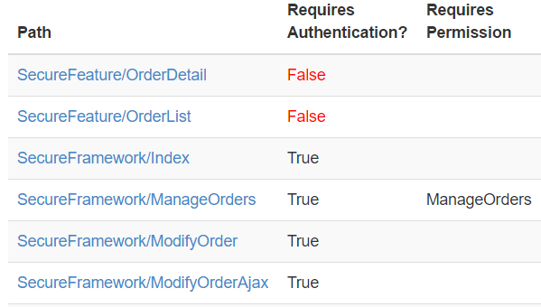
Authorization auditing

Slide 68
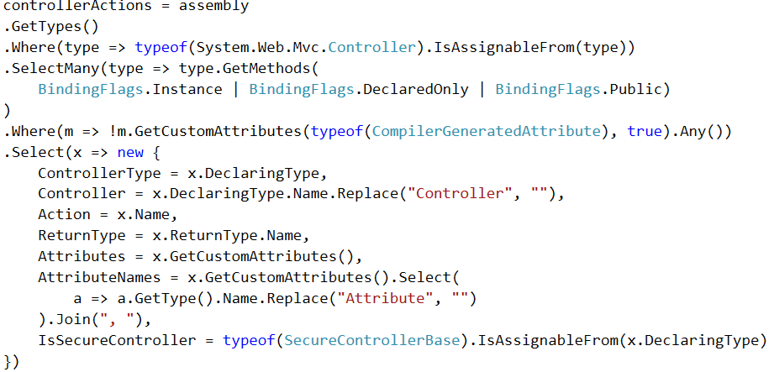
Authorization auditing

Slide 69
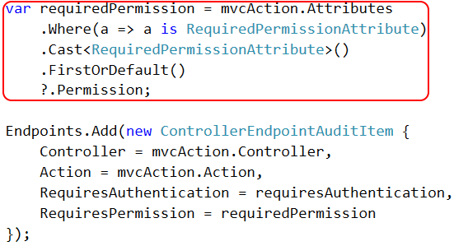
Authorization auditing

Slide 70
Authorization auditing

Slide 71

http://approvaltests.com

Slide 72
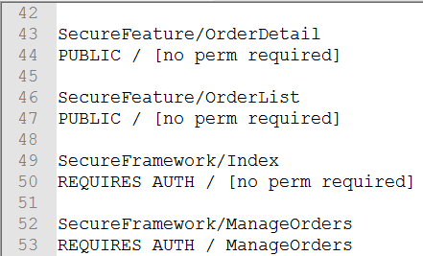
Approval Tests – Step 1

Slide 73
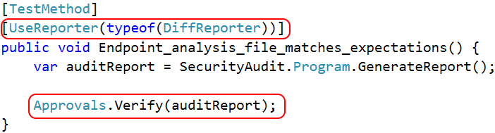
Approval Tests – Step 2

Slide 74
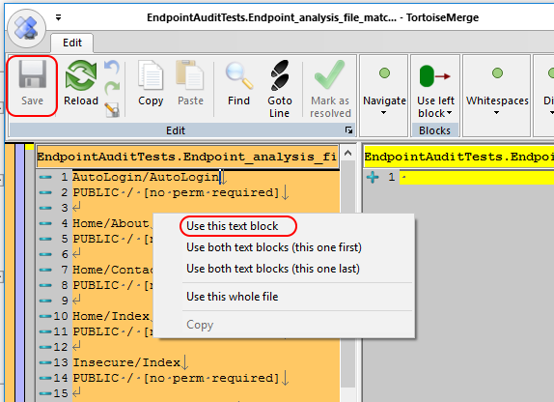
Approval Tests – Step 3

Slide 75
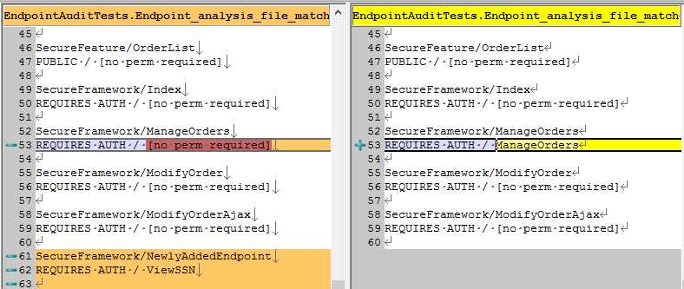
Approval Tests – Step 4

Slide 76
What makes auditing easier?
Using [Attributes] to decorate classes/methods
Inheriting a base class
Implementing an interface

Slide 77
Recap – 55 minutes of knowledge, 1 slide
Cross cutting concerns ➔ framework code
"Secure by default" is the holy grail
Declarative > imperative
Automated audits > exhaustive testing
bit.ly/2i0J91d
github.com/spetryjohnson | www.petry-johnson.com
@spetryjohnson

